Slide 1
Restaurant Guide

Slide 2
Restaurants in New delhi
There are 5000+ restaurants available in New Delhi
To bring ease to the diner, this model helps diner by showing the best restaurant in the locality.
Foursquare API is used in the end to view the reviews of the particular restaurant.
For now, recommendations are based on locality and cuisine.

Slide 3
Targeted Audience
This can be used by anyone who is looking for a good restaurant to dine out whether it is someone who lives in the locality or someone who is just in town on vacation or for weekends.

Slide 4

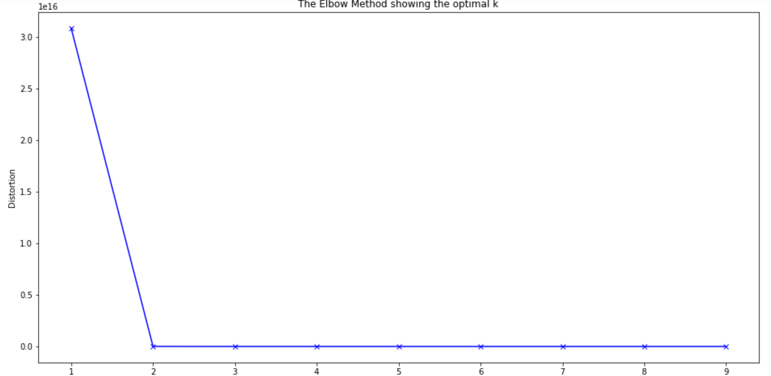
Machine Learning Model Used
In this project, K-mean clustering is used for both i.e when analyzing data for locality as well as for cuisine to group data.
Later with the help of number of cluster graph is plotted.
Used elbow K mean elbow method to get optimal K value

Slide 5
Foursquare API
Foursquare API is a RESTful api using which one can gather information about a venue, user, location etc.
After analyzing data foursquare is used to get reviews and other information for particular restaurant

Slide 6
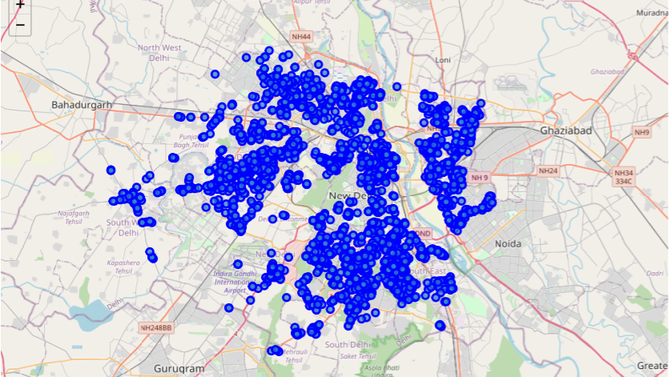
All Restaurants in New Delhi

Slide 7
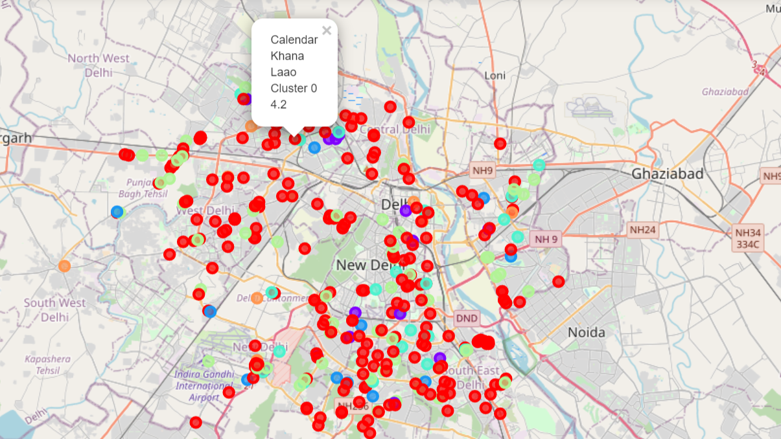
Restaurants with highest rating (locality-wise)

Slide 8
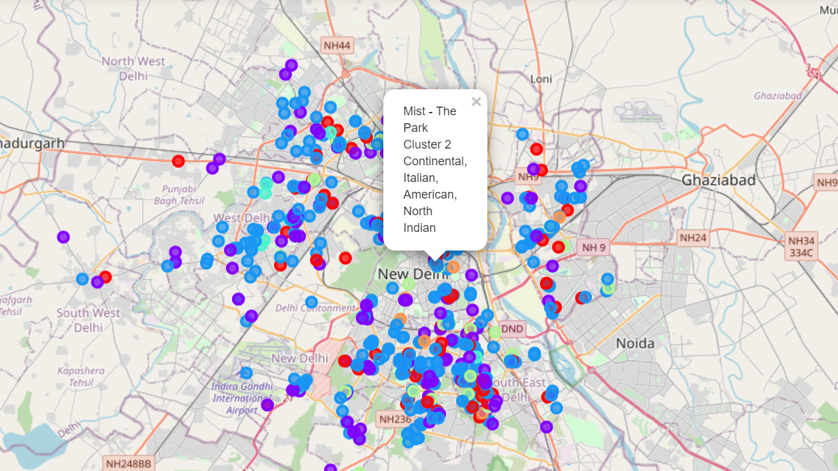
Restaurants with highest rating (cuisine-wise)

